Slide 1
Octave
A Generative Music Engine using Genetic Algorithms
Abhiram Kothapalli

Slide 2
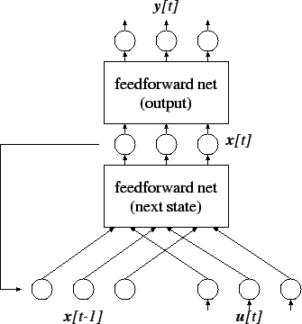
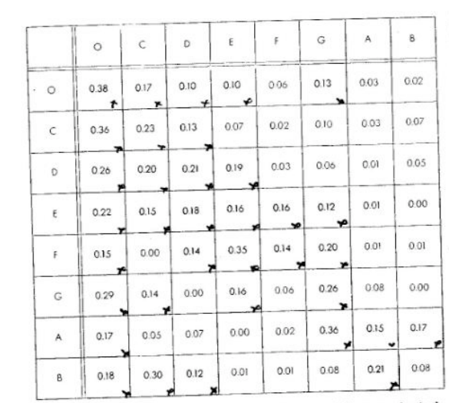
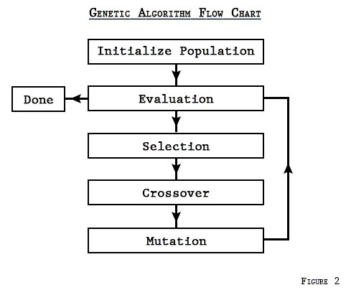
How can we algorithmically create music?
Recurrent NN
Markov Matrices
Genetic Algorithms

Slide 3
Key Insight: Genetic Algorithm on Markov Matrices
Generation N
Generation N + 1
Weighted selection based on fitness
breed(M1, M2)
mutate(M)
fitness(M)

Slide 4
Choosing a Fitness Function
What makes music good?
Ascending/Descending Notes
Pauses
Long/short notes
Unexpected Jumps
We can make simple but effective rules

Slide 5

Results. Let’s Listen
Random
Long notes
A/D Pentatonic

Slide 6
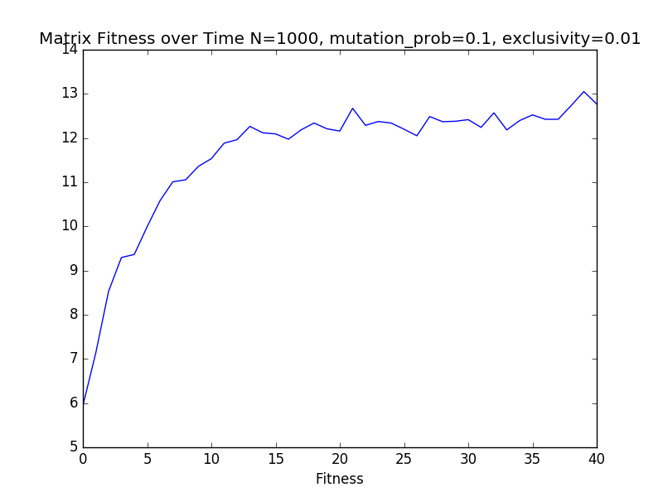
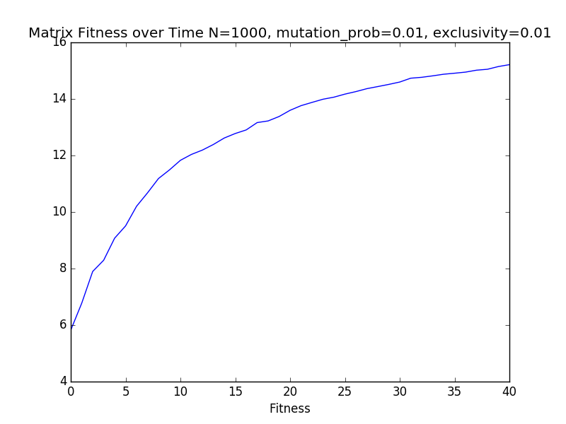
Fitness over time based on mutation

